Slide 1
AR card game
Team 5

Slide 2
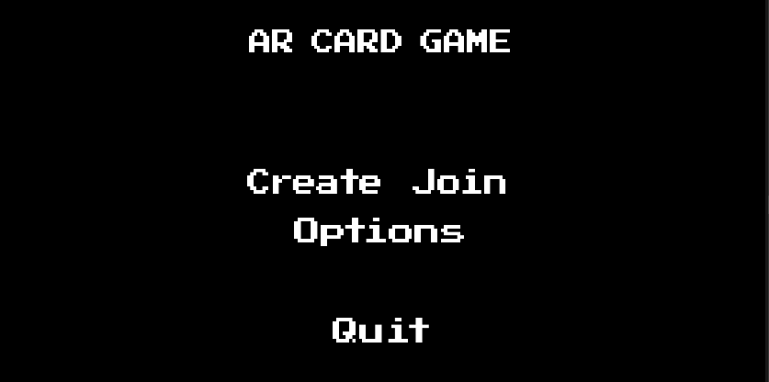
Main

Slide 3
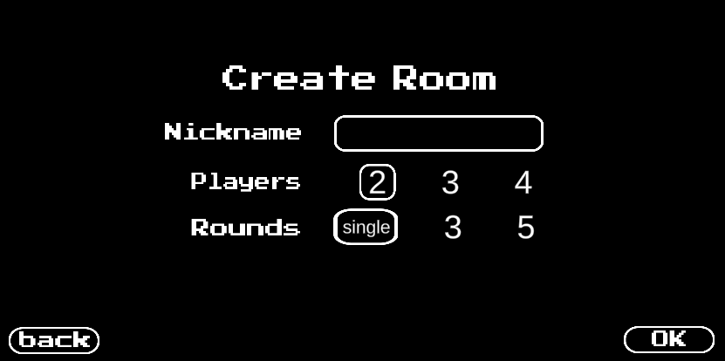
Create

Slide 4
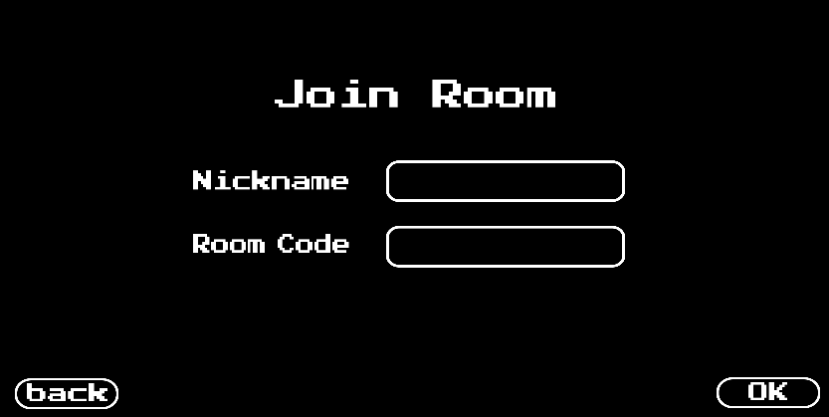
Join

Slide 5
AR Features
Image Tracking
Plane Detection

Slide 6




Image Tracking
Can detect four markers at once
Random card among total 52 cards appears on the marker

Slide 7
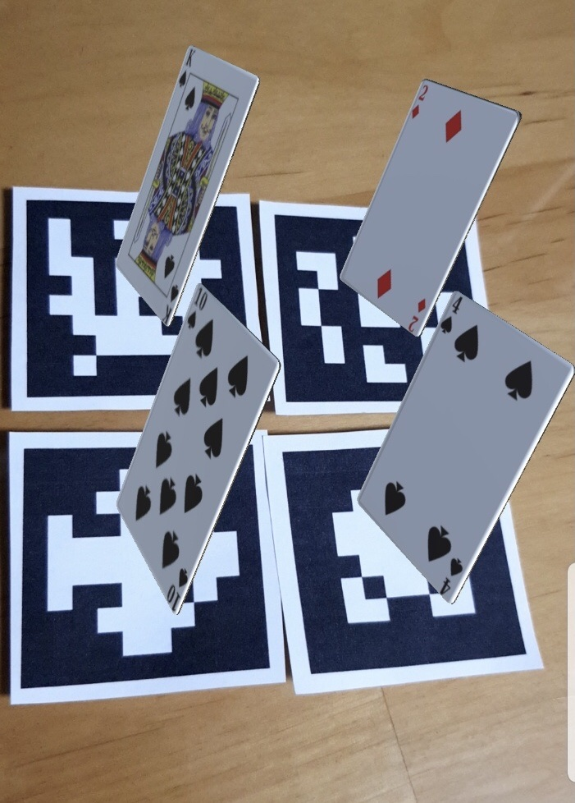
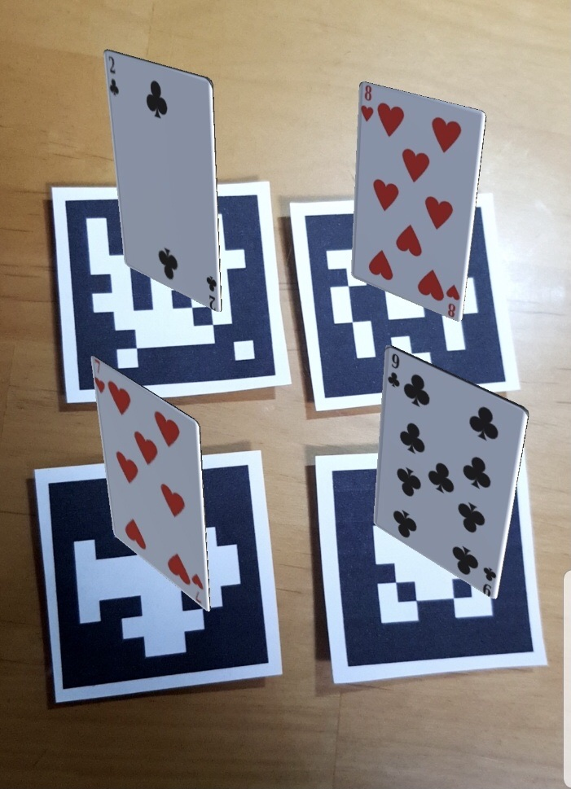
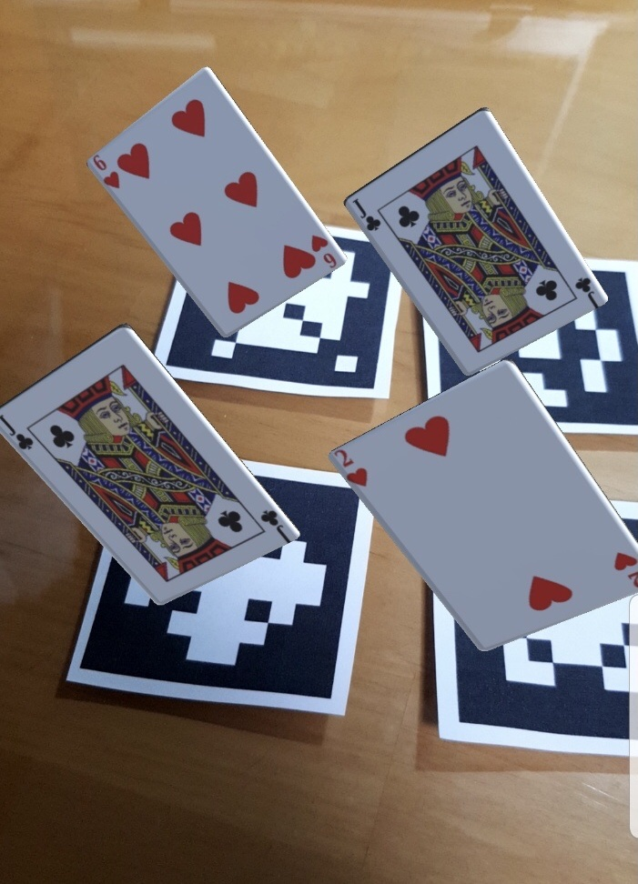
Image Tracking

Slide 8
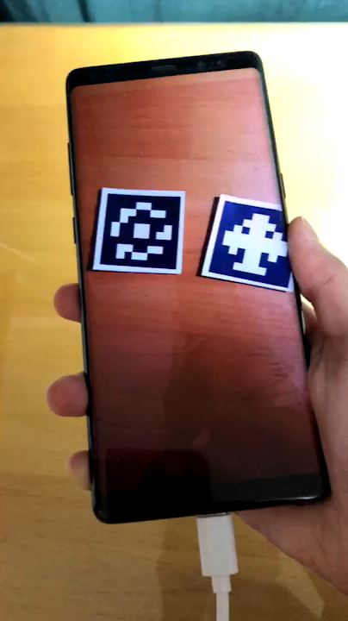

Slide 9
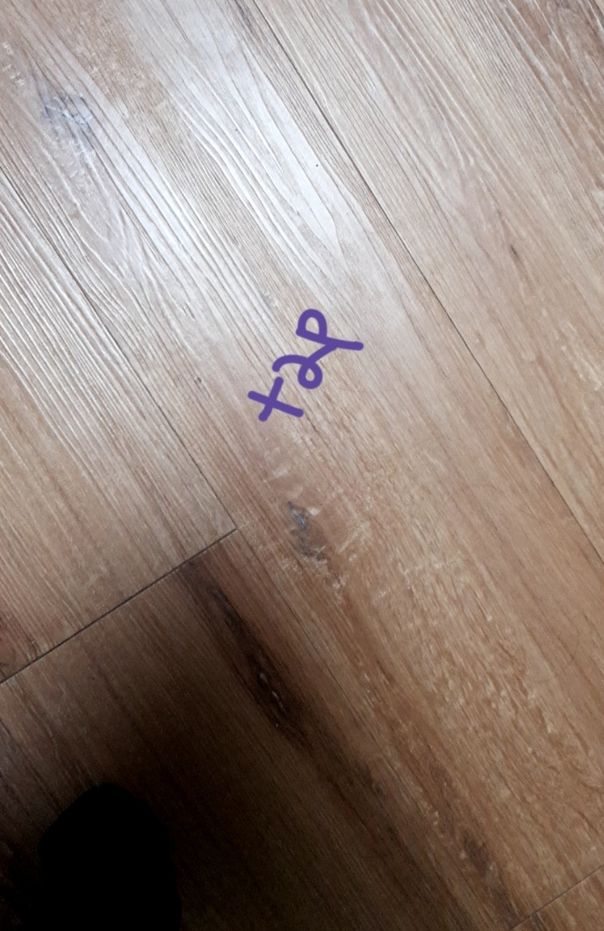
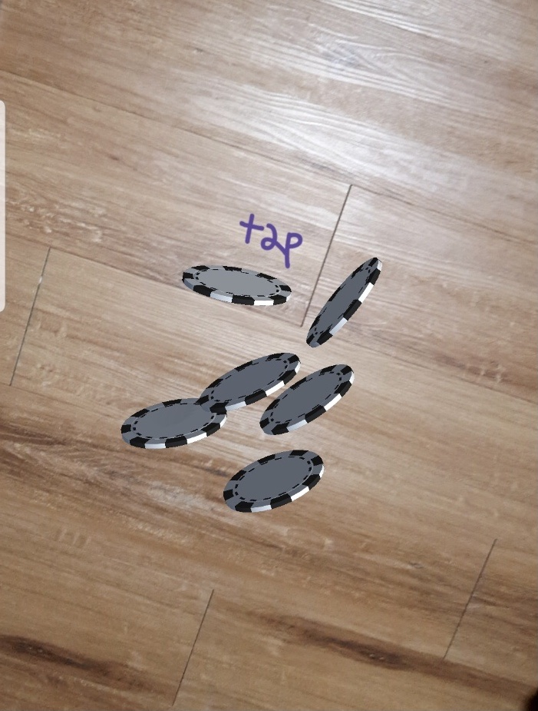
Plane Tracking

Slide 10
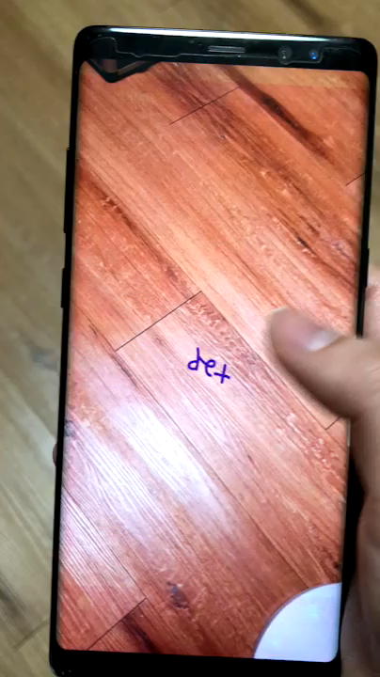

Slide 11
Thank you

